Slide 1

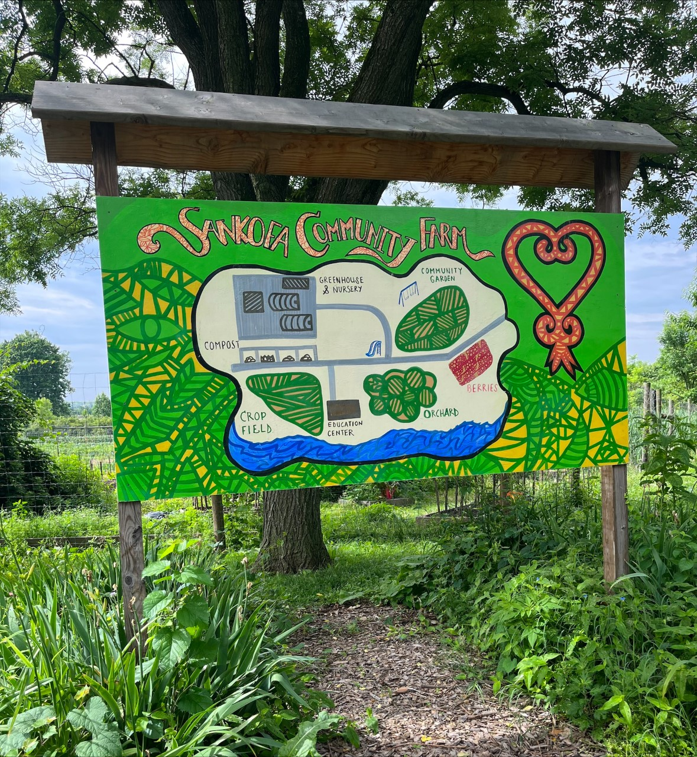
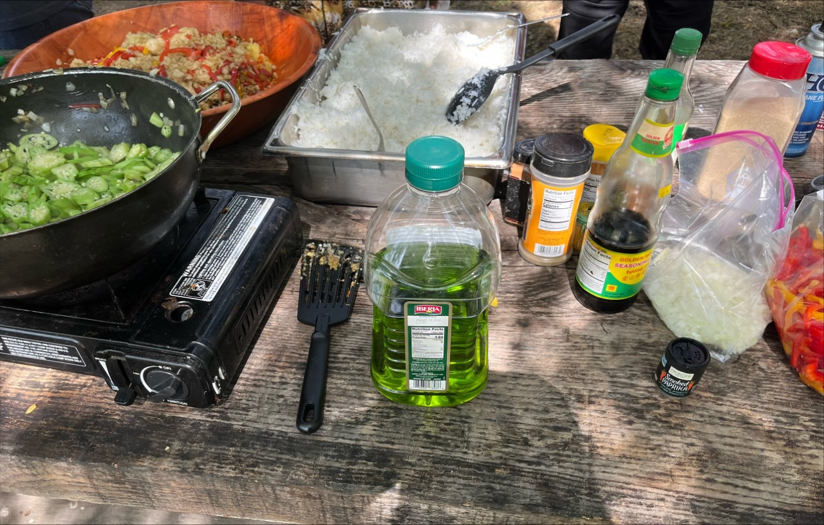
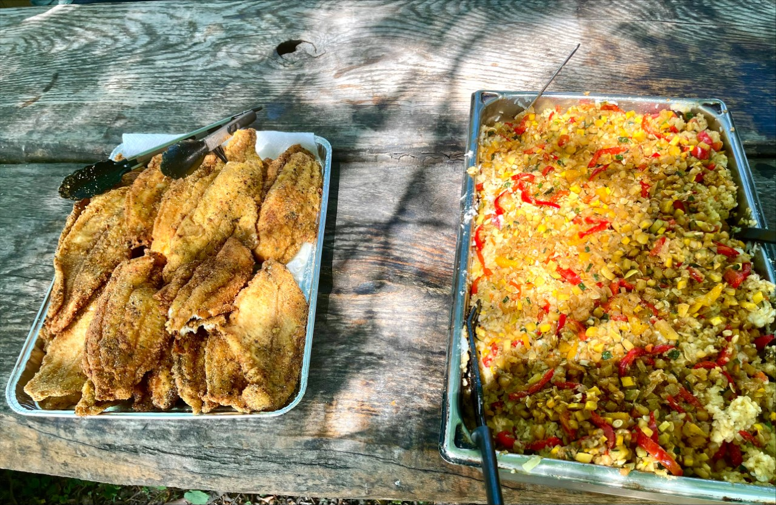
Bridging the Gaps: Sankofa Style
Student Interns
Samuel Curry, University of Pennsylvania, Perelman School of Medicine
Michelle Wu, University of Pennsylvania, School of Nursing
Community Preceptors
Tyler Holmberg, Co-Director, Sankofa Community Farm at Bartram’s Garden
Academic Preceptors
Hillary Bogner, MD, MSCE, Perelman School of Medicine
Ann L. O’Sullivan, PhD, FAAN, CRNP, School of Nursing
Christopher Renjilian, MD, Perelman School of Medicine
COMMUNITY PARTNER
The Sankofa Community Farm at Bartram’s Garden is a 3.5 acre crop farm that is not only spiritually rooted in the African Diaspora, but also establishes food sovereignty in West and Southwest Philadelphia area
The farm:
Grows 60+ different crops
Produces over 15,000 pounds of food
Provides space for around 50 garden beds for local community members
TEAM’S EXPERIENCE
Supported the summer youth program
Harvested crops
Assisted with cooking and farm crew
Sold crops at various markets
ACCOMPLISHMENTS/
CHALLENGES/
JOYS
Prepared delicious meals 3 times a week for 40 people
Led a wellness session for 28 summer students
Taught the summer students how to grow and maintain certain crops
REFLECTION
“Overall, my experience at Sankofa Community Farm taught me the intersection of culture, nutrition, food justice, and health. Knowledge gained during BTG internship increased my awareness of my surroundings and engagement. Finally, I hope to bring forth the skills learned such as listening, and patience into my nursing career. ”
- Michelle Wu
“Working at the Sankofa Community Farm taught me a myriad of skills that are not only applicable to my career of interest (medicine), but also in community engagement. Because of my site, I gained new insights on leadership, community cohesiveness, and a deeper understanding of the African Diaspora experience. I am grateful to have such a rare experience.”
-Samuel Curry

