Slide 1
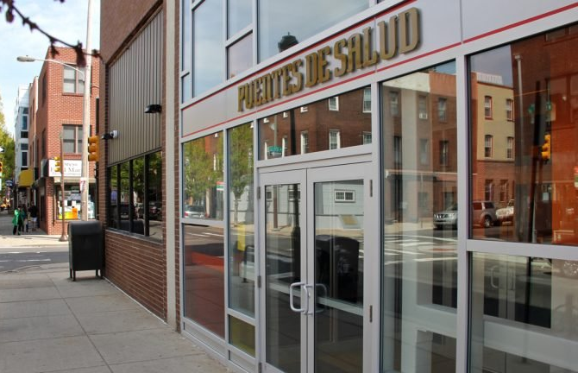
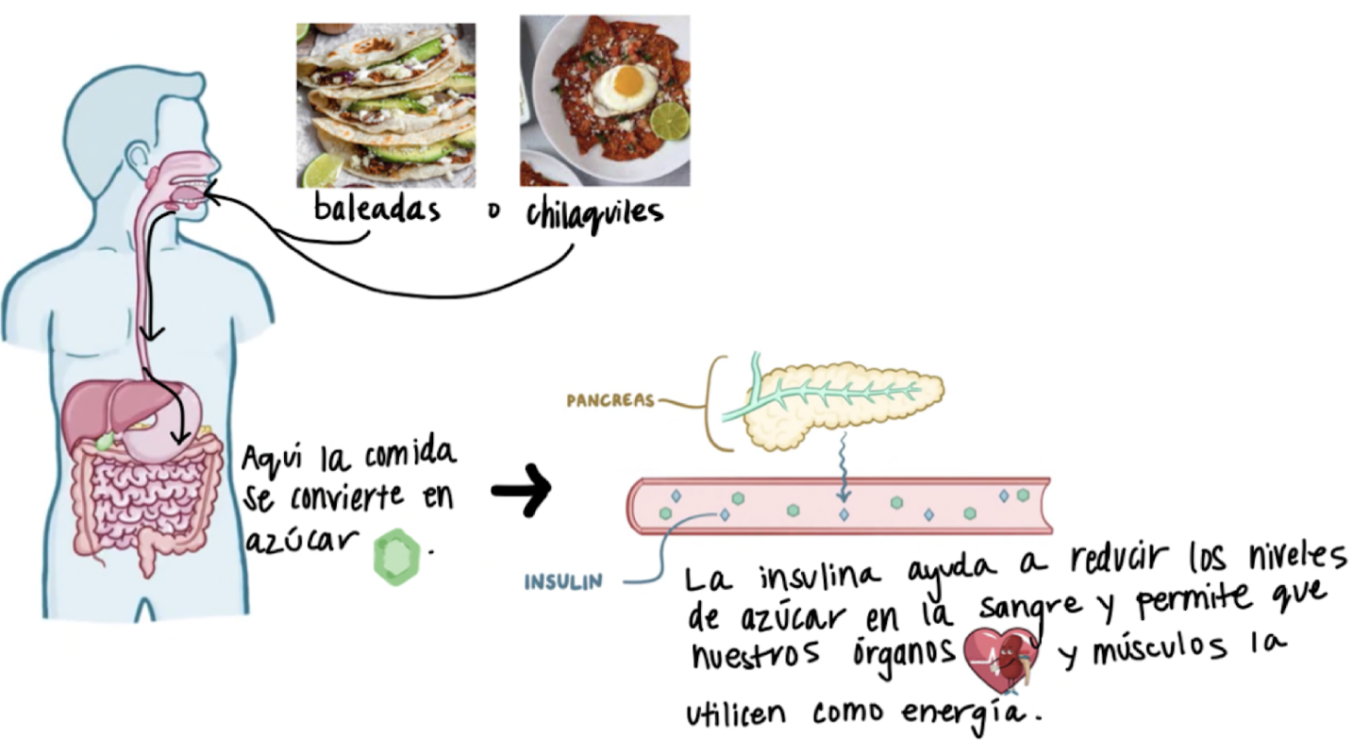
Expansion of Health and Wellness Services at Puentes de Salud
Student Intern: Brittany Chavez, Thomas Jefferson University, Sidney Kimmel Medical College Class of 2025
Academic Preceptor: Maria Hervada-Page, MSS, Clinical Assistant Professor and Assistant Residency Director, SKMC at Thomas Jefferson University
Community Preceptor: Leah Reisman, PhD, Health & Wellness Director at Puentes de Salud
COMMUNITY PARTNER
Puentes de Salud is located in South Philadelphia and provides the Latinx immigrant community medical services, educational programs, and other wellness programs for community building. These programs include food access, art, behavioral health, and medical-legal partnership. Their mission is to partner with Philadelphia’s rapidly growing Latinx immigrant community to build long-term prosperity by addressing immediate education, health and social service needs. They offer integrated services to support full mental, emotional, and physical well-being from the individual to the community.
https://www.puentesdesalud.org
BACKGROUND/CONTEXT
Previous studies have identified determinants of poor mental health and substance use disorders in the Latinx immigrant population. They result from enduring difficult conditions before, during and after migration. In an analysis of ~6 months of Puentes’ 2021 case management client data, mental health was one of the most frequent needs expressed by clients. In an effort to expand the behavioral and mental health capacity, Puentes added an additional provider and will train the promotoras (community health workers) to facilitate pilot support groups.
The Food Pharmacy at Puentes is open during clinic hours and distributes culturally appropriate food, diapers, and hygiene items. It was established during the pandemic. The Food Pharmacy also provides nutrition information and education about diabetes and other chronic health conditions via the promotoras.
TEAM’S EXPERIENCE
ACCOMPLISHMENTS/
CHALLENGES/
JOYS
I supported the expansion of the behavioral and mental health services by conducting research for mental health training materials and culturally competent mental health screener tools for the Latinx immigrant community. I created an annotated bibliography that can be referenced by anyone else who will contribute to the training development. I adapted and translated relevant material so that it can be used to facilitate training sessions for the promotoras.
I assisted clients in the Food Pharmacy on Mondays and Thursdays as they picked up food and other essential items. I gathered recipes that will be handed out to clients. The recipes have suggestions for foods that are distributed but clients often have little experience with.
In response to the promotoras’ concerns of patients poorly managing their diabetes, I created a comprehensive guide for patients. The guide informs patients on symptoms, management, complications, and nutrition education.
I had meaningful conversations with the promotoras and learned how they the facilitate their consults or “charlas” with community members. They provide a comfortable and trusting environment for patients to learn how to manage their conditions. These conversations helped me develop an appropriate diabetes guide for patients. Near the end of my experience I led a meeting in which I presented my materials. I received great feedback from the Food Pharmacy team and medical providers in the clinic.
I helped the food access and case management coordinator provide clients with a variety of services; financial, medical and other important documentation. I had the opportunity to take the lead on my own clients and enjoyed getting to know them as I assisted them.
I delve into research on mental health in Latinx immigrant communities. Although unsurprising, it was disappointing to face the reality that there is a huge need for services but little access.
REFLECTION
My internship at Puentes de Salud taught me that there is power in community and it can be extremely challenging for undocumented, Spanish-speaking families to find this when they settle in this country. Whether I was helping a client with a financial assistance program or having a promotora teach me portion sizes using the palm of my hand, I felt a sense of belonging. Part of that is because I am a brown, native Spanish-speaking woman whose own mother had to navigate the system in similar ways to patients I have met at Puentes. However, it is also because Puentes de Salud has staff that is willing to accommodate for and meet patients where they are in their health and healing journeys. Throughout my career I will reflect on my experience at Puentes de Salud and be reminded that empowering my community is possible when all social determinants of health are taken into account.

